Slide 1
Political and constitutional developments in British India 1911-1929
Change in Muslim Politics
Lucknow Pact 1916
Montague-Chelmsford Reforms 1919
Khilafat Movement
Prejudicial attitude of Hindus and change in Muslim league politics

Slide 2
Change in Muslim Politics
The partition of Bengal was annulled in 1911 by the British government.
The Muslim league became dismayed of this action of the government, because the Muslim were benefiting from the partition of Bengal.
The war was breaking out between Italy and Turkey in the Tripoli and the Balkan region
These local and global reasons compelled the Muslim League to change its line of action from loyalty to the British government to the self-rule.

Slide 3
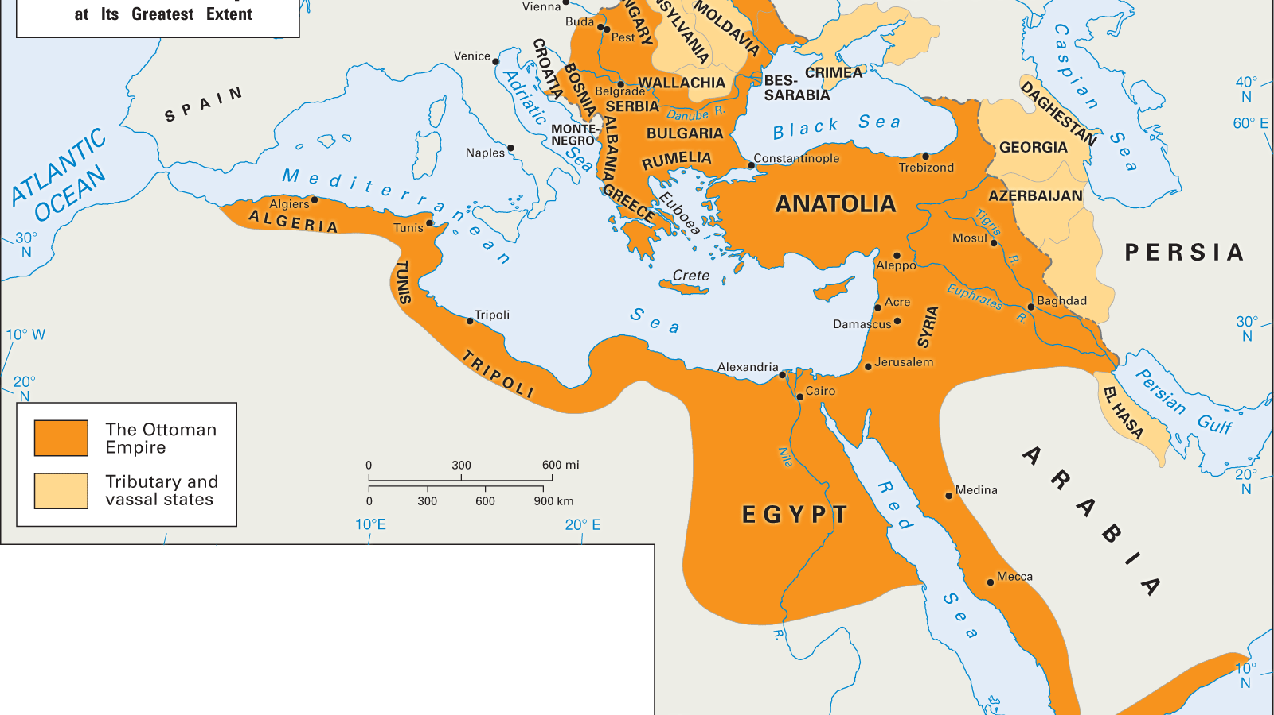

Slide 4
The Muslim league decided to join hands with Indian National Congress for the attainment of self-rule in India.
The Muslim league office was shifted to Lucknow from Aligarh in 1913.
The younger generation had assumed the leadership of the Muslim league. Quaid-i-Azam had joined Muslim League in 1913. He was also the member of Congress at that time.
On 22 March 1913, on the initiative of Quaid-i-Azam Muslim league passed a resolution to adopt the attainment of self-rule in India suitable to India under British Crown through constitutional means instead of giving loyalty to British rule.

Slide 5
Lucknow Pact 1916
Quaid-i-Azam was the member of Congress and Muslim League at the same time.
He asked the leaders of Muslim league to hold their annual session at Bombay where Congress was also holding its session in 1915.
The Muslim league leaders accepted the suggestion of Quaid-i-Azam. A reform committee to appointed to bring forth solutions for the problem of Hindus and Muslims, and to demand the constitutional reforms.
In December 1916, the Muslim League again held its annual session with Congress at Lucknow. Quaid-i-Azam presided over the session.

Slide 6
Main points
The members would be elected directly by the people for a term of 5 years.
The Muslims shall be elected through separate electorates and their strength in the different provinces shall be as follows;
Punjab 50%, Bengal 40%, U.P 30%, Bihar 25%, CP 15%, Madras 15%, Bombay 33%; Seats were reserved for the Muslims in those provinces in which they were in minority under the system of weightages.
No bill or any clause thereof nor a resolution introduced by a non-official member affecting one or another community shall be presented in the assembly without the approval of the concerned group.

Slide 7
Protection shall be given to the Hindus in Muslim majority provinces.
End of world War I and Montague-Chelmsford Reforms
A strict policy was suggested in the report against those who were found involved in the political activity against the British government during the World war-I.
A committee was appointed under chairmanship of Justice Sidney Rowlat. In 1918, the committee presented its results to the British Government.
As a result of which Rowlatt Act came into being. The act gave provincial authorities widespread powers to control the political activities
As a reaction to the report Quaid-i-Azam resigned from the Imperial legislative council.
The Indians gathered at Jallianwala Bagh in Amritsar, Punajb to protest the Rowlatt Act. The British commander General of the region Dyer opened fire on the protestors without giving them time to disperse.

Slide 8
Montague-Chelmsford Reforms
However, these incidents contributed in the development of the feelings of hatred among the people against the British rule.
Hence, to eliminate these feelings the British government introduced constitutional reforms in India
Main points of 1919 act
Bicameral legislature was established in the center. The upper house was known as the council of state and the lower house was named as central legislative assembly.
Separate electorate was retained for the Muslims.
The system of Diarchy was introduced at the provincial level. By this system, the provincial subjects were divided into two categories known as the transferred and the reserved subjects.
Transferred subjects: health, commerce, education,
Reserved subjects: law and order, finance, police irrigation, and forests

Slide 9
Khilafat Movement
When Word War-I broke out the seat of Khilafat was situated in Turkey. When Britain declared war against Turkey. The Muslims of India considered it as a war against the Ottoman Khilafat.
Gandhi became part of Khilafat movement due to the massacre of people at Jallianwala bagh.
In 1918, the khilafat conference was held in Delhi. The delegates pressurized the British government that the Khilafat in Turkey should not be changed. At that time Maulana Muhammad Ali and Shaukat Ali were in jail.
When they were released, they attended the session of AIML and INC in Amritsar and formed Khilfat committee. The Khilafat committee was given the dual task on the one hand it had to keep the institution of Khilafat unchanged, and on the other hand they wanted that the Holy places (Mekkah and Medina) of Muslims must not be part of any terms and conditions.

Slide 10
Khilafat committee met the British government. They demanded that the British and its allies must not touch the Holy sites of Muslims, and the institution of Khilafat must remain unchanged
The Khilafat committee met again on 23rd November 1919, and a delegation was sent to England under the leadership of Maulana Muhammad Ali Jauher in order to communicate their demands to the Prime minister of Britain, Lloyd George.
They demanded Lloyd George that the institution of Khilafat must remain unchanged. Lloyd George declined to listen to their demands and declared that Turkey must not be excused.
Treaty of Sevres 1920
The World War-I was finally reached its conclusion formally when the Treaty of Sevres was signed in 1920. Turkey was divided, and new states of Armenia, Iraq, and Jordon were established.

Slide 13
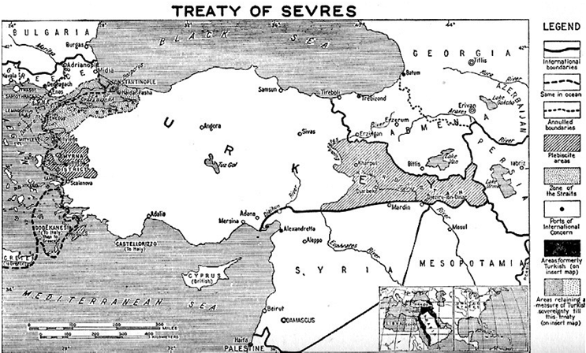

Slide 14
The western Anatolia, and Samarna was given to Greece. The dismemberment of Turkey meant that the institution of Khilafat was also fated to wither away.
The British had not reversed the terms of the treaty as a result of which the Muslims of India launched non-coperation movement under the leadership of Gandhi.
The plan of non-cooperation movement was to boycott all the British institutions or goods.
Indians would give up the government services, and titles; boycott all the law courts, schools, colleges, and the elections which were announced under the Montague-Chelmsford reforms of 1919.

Slide 15
The foreign clothes were burned, and khaddar became the clothes of the Indian people.
The Charkha or spinning wheel became the mark of Indian independence.
Hejrat movement
Maulana Abdul Kalam Azad and Maulana Abdul Bari issued fatwa that India had become Dar-ul-Harb (home of war), where the Islam is threatened.
They demanded the Muslims to migrate to that region where Islam was not threatened.
As a result of which almost 18 thousand Muslims migrated to Afghanistan.
Initially the Shah of Afghanistan welcomed them but afterwards when the number of the migrants increased, he started to send back the refugees.

Slide 16
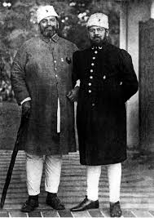
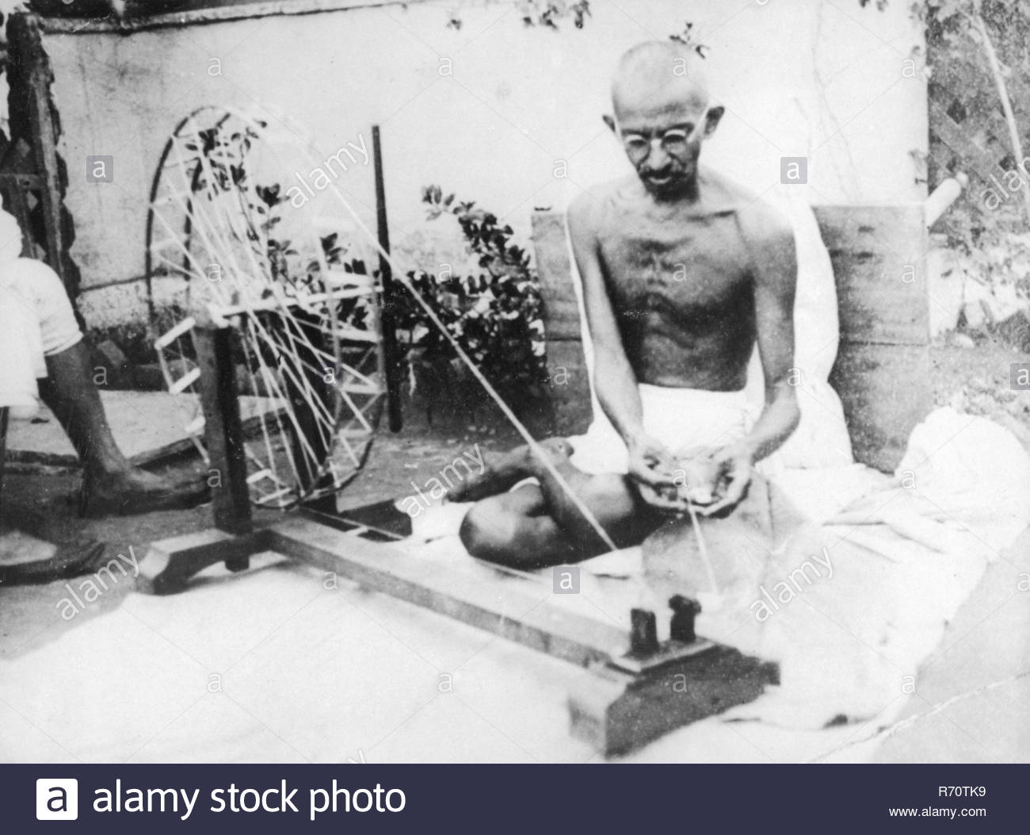

Slide 17
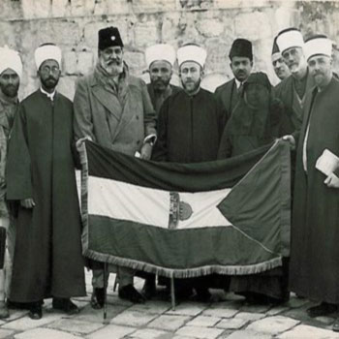

Slide 18
Moplah Uprising
On the Malabar coast of India, The Moplah Muslims of Arab origin were settled. They actively took part in the non-cooperation movement.
The British government adopted repressive measures to quell the uprising
They arrested many Moplah Muslim leaders who wanted to reach Kerala for launching the Khilafat movment.
The Moplah demanded the British government to release their arrested leaders.
The police opened fire on the protesting mob due to which almost 400 people were killed.

Slide 19
Chauri Chaura tragedy
Gandhi intended to begin the non-cooperation movement from a small town of Chauri Chaura in Farakhabad district in 1922.
The people of Chauri Chaura demonstrated in the form of procession on 5th February 1922.
The police tried to disperse the procession which enraged the protesting people. Demonstrators set fire to the police station as a result of which almost 22 policemen were burned alive.
The movement no longer remained non-violent and Gandhi was compelled to call off the civil-disobedience movement.
Gandhi without consulting from any leader of Khilafat committee called off the civil-disobedience movement

Slide 20
End of Khilafat movement
The institution of Khilafat was demolished by Mustafa Kamal Ataturk on 1 November 1922.
The last Khalifa was banished from Turkey in 1924. The Khilafat movement in India ended without achieving its goal.

Slide 21
Simon Commission 1927
In 1919, when the Montague-Chelmsford reforms were introduced, it was also decided that after ten years the reforms would be revisited in order to introduce more reform in British India.
The British government appointed a commission under Sir Simon to report on the constitutional progress in India.
The commission was consisted of all the British members and not a single Indian was its member.
The Congress and Muslims League due to the absence of Indian members, decided to boycott the commission.
The commission, despite of the non-cooperation of Congress and Muslim League, prepared the report for constitutional reforms in India

Slide 22
The recommendations were sent to the British government for the approval.
A constitutional reform scheme was prepared by the British government.
Congress and Muslim League both decided to not accept the scheme prepared by the British government.
Lord Birkenhead, the secretary of state for India, had declared that the Indians were divided, and they could not produce an agreed upon constitution.
Delhi-Muslims Proposal
Nehru asked Quaid-i-Azam that if Muslim League surrender the right of separate electorate, the Congress will accept any demand put forward by the Muslim League
Sindh should be separated from Bombay
Reforms should be introduced in Baluchistan and NWFP, and they should be given the status of province.

Slide 23
The Muslims should have 1/3 representation in the central legislature, as already granted.
The Muslims should be given representation in Punjab and Bengal according to their population
The Lahore group of Muslim League lead by Sir Muhammad Shafi disapproved the proposals and opposed it. The Congress and the Hindu leader initially welcomed it, but later they also opposed the proposals
Nehru report 1928
The Indian leaders decided to accept the challenge of Lord Brikenhead. They called an all parties conference (APC) in February 1928
A committee was appointed in the all parties’ conference to prepare a draft for the future constitution

Slide 24
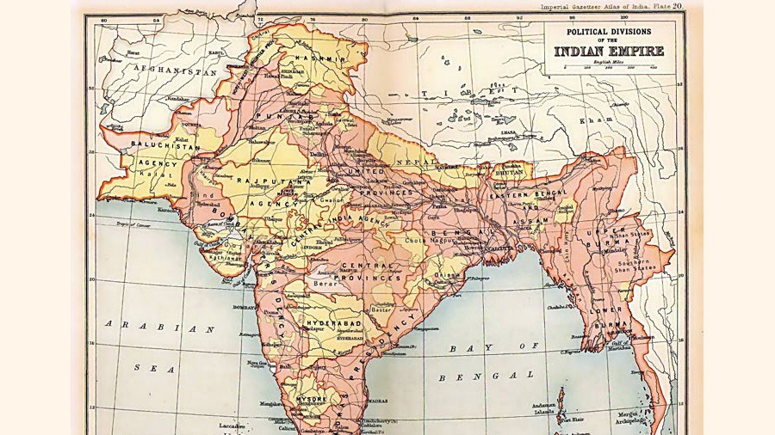

Slide 25
The committee was presided by Motilal Nehru.
Major Points
Self-governing government under the dominion status should be given to India.
Separate electorate should be substituted by joint electorate, by reserving seats for the minorities as per their population.
The foreign affairs, defense, and army should be under the parliament and the viceroy.
Sindh should be separated from Bombay, if it was able to bear the experience.
Provincial status should be given to N.W.F.P and Baluchistan.
Unitary form of government should be established in the center.
Hindi should be made the official language.

Slide 26
APC and Nehru Report
They threatened the British government of launching a non-cooperation movement, if the report was not employed until December 1929.
Muslims demanded changes in Nehru report in the APC which was held at Calcutta
Quaid-i-Azam proposed three amendments,
1/3 representation of the Muslims in the central legislature.
Representation should be given to Muslims in Bengal and Punjab as per their population.
Residuary powers should be given to the provinces.
The changes that were proposed by Quaid-i-Azam was rejected during the voting at the APC.

Slide 27
All Parties Muslims Conference 1929
An all parties Muslim conference was held under the chairmanship of Sir Agha Khan at Delhi in January 1929.
The conference decided to put forward certain demands of the Muslims which were;
Separate electorate should be retained for the Muslims.
Federal system should be introduced with full provincial autonomy.
1/3 seats should be given to Muslims in central legislature.
Muslim majority representation should be recognized in Punjab and Bengal.

